Slide 1

AVI FINAL PROJECT
KEITH NG JO HANN
LIM WEI JIE
SENG EN HUI
TAN XIN AN SAMUEL

Slide 2
SIGNALS USED
01
METHODOLOGY
02
TABLE OF CONTENTS
RESULTS
03
04
FUTURE IMPROVEMENTS/RECOMMENDATIONS
Gross Profit Margin
Size Factor and Value (Book-to Market) Factors
F-Score
Year-by-year Regression on signals chosen
Portfolio Optimisation
Backtesting
Comparison to Benchmark
Limitations
Sentiment Analysis
05
CONCLUSION
Notes:
1. Signals
- Novy
- Fama
- F-Score
2. Methodology
- Portfolio Formation
- Backtesting
3. Results
- Comparison to Benchmark
4. Future improvements
- sentiment

Slide 3

Signals
01

Slide 4

A. Gross Profit Margin

Slide 5
Gross Profit Margin
Based on Novy-Marx’s Paper, “The other side of value: The gross profitability premium”
Novy-Marx found that the Gross Profit Margin was a strong predictor of future stock returns
Returns on high profitability firms were significantly higher than those of low profitability within each size quintile.
Key Takeaway:
Investors can identify firms with high stock returns through their Gross Profit Margins, especially when their investment strategy involve high BM firms

Slide 6
B. Size and Value Factors

Slide 7

Size and Value
Tests conducted by Fama and French do not support even the most basic prediction of CAPM
The pair aimed to prove that stock risks were multidimensional, hence justifying that the CAPM could be further built upon by adding several factors, such as the size factor and the Book-to-Market Ratio
Key Takeaway:
High book-to-market stocks, also known as value stocks, have been shown to perform better than low book-to-market stocks. These stocks also tend to be small and in financial distress.

Slide 8
C. Piotrowski’s F-Score

Slide 9
Financial Health
Building on Fama and French, Piotrowski found that he could further divide high BM firms into high quality and low-quality firms with his F-Score
Because high BM firms tend to be small, neglected by analysts, the most reliable information on their financial health would be from their financial statements.
Key Takeaway:
Piotrowski’s F-Score has shown to be a robust predictor with small firms that are thinly covered. Its effectiveness decreases as firm size and information dispersion increases.

Slide 10
D. Portfolio Formation

Slide 11
Year-by-year regression on our chosen signals
Data Collection of annual accounting data and monthly stock returns
Key Takeaways:
Significant t-stat/p-value for Market Value and F Score.
We can expect larger contribution to our portfolio returns from Market Value and F Score.
Still selecting BM and Gross Profit Margin as signals due to research done
Step 1
Calculating the signals in Python. Compounding monthly returns to get annual returns
Step 2
Step 3
Conducting a year-by-year regression of annual returns on chosen signals
Step 4
Analyze results
 | t-stat | p-value
Constant | 2.6693 | 0.0173
Market Value | -2.5647 | 0.0225
Gross Profit Margin | -0.8884 | 0.3894
F-Score | 2.6149 | 0.0204
Book-to-Market | -0.5882 | 0.5658

Slide 12
Portfolio Formation
Filter for high quality firms regardless of size
Universe of all US Stocks between 2003 and 2018
Choose the top 40% of Gross Margin
Filter for value factor
Choose the top 40% of BM ratio
Filter for small firms only so that our F-Score will be more robust as a predictor
Choose the smallest 50% of firms
Choosing firms in strong financial health
Choose firms with F-Score ≥ 8
Final Portfolio

Slide 13
Methodology
02

Slide 14
Portfolio Optimisation

Slide 15
Mean-Variance Optimisation
In a paper by Harry Markowitz on the Modern Portfolio Theory(MPT):
“An investor can maximize his portfolio’s expected return for a given level of risk by altering the proportions of the various assets in the portfolio”
Main Assumptions of MPT:
An investor has to take on higher risk to achieve greater expected returns.
A portfolio’s overall risk can be reduced through diversification across a wide variety of security types.

Slide 16
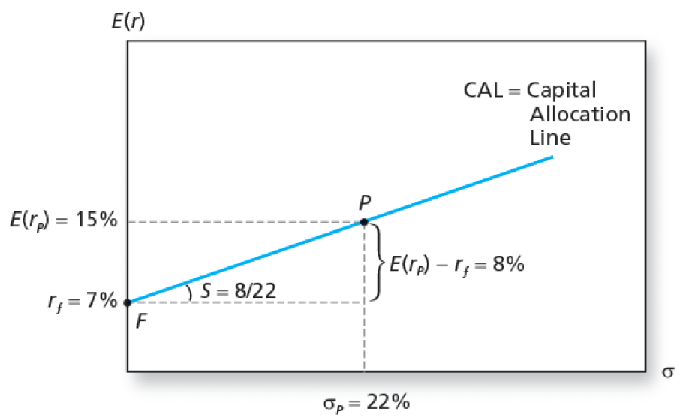
Mean-Variance Optimisation
Consider 1 risky asset & 1 risk-free asset in a portfolio:
Investors can use CAL to choose how much to invest in a risk-free asset and risky asset.
Slope represents returns-to-risks ratio (𝝙y/𝝙x)

Slide 17
Mean-Variance Optimisation
Key Question to ask:
What if an investor wants to select zero risk-free assets and 50 risky assets?

Slide 18
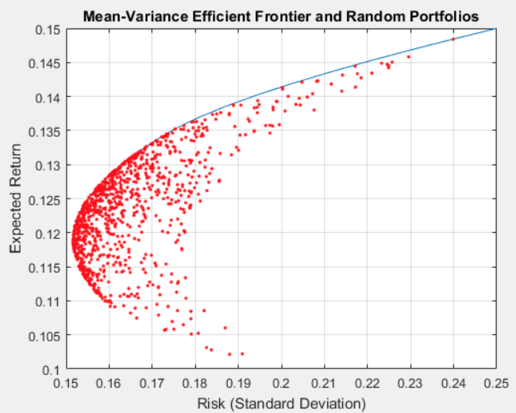
Mean-Variance Optimisation
Consider generating 10,000 portfolios by random selection, each portfolio will contain a different set of weights for the assets.
The above when plotted will look like this:

Slide 19
Mean-Variance Optimisation
Key Takeaway:
We can simply choose the set of stocks that are on the blue line as they offer the best expected returns based on the specific risk level, compared to others.

Slide 20
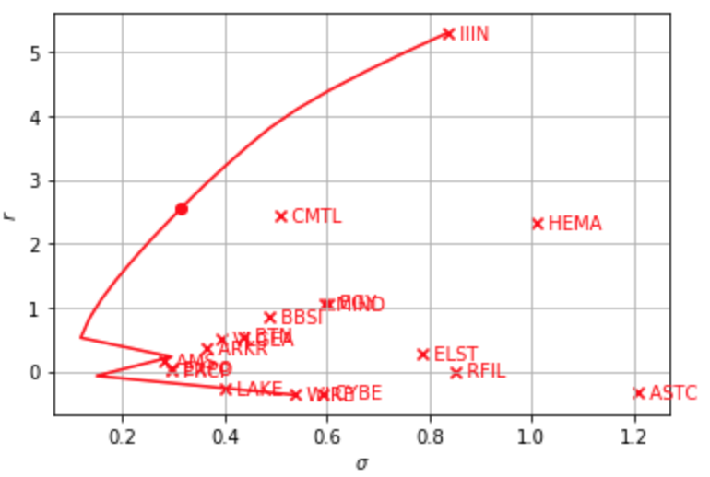
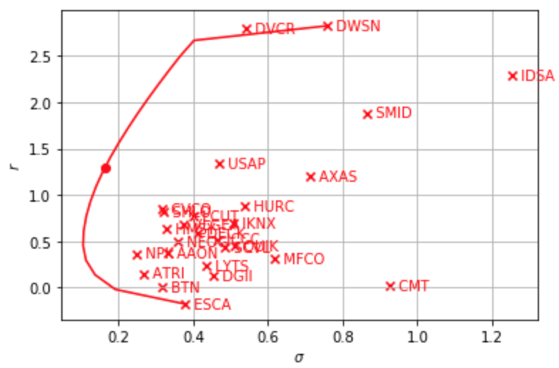
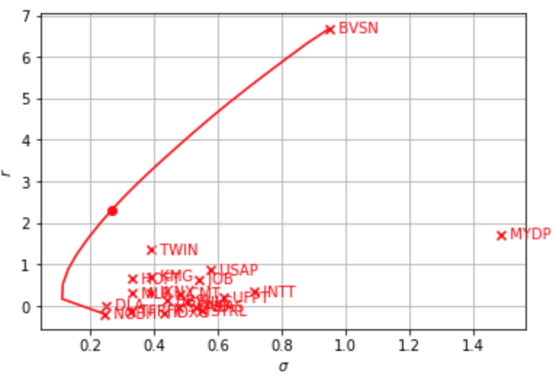
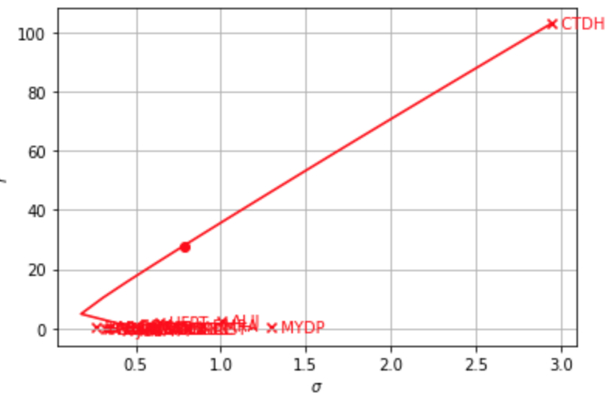
Mean-Variance Optimisation
For every set of stocks selected based on our signals, we plotted yearly mean-variance graph:
Jun ‘05 - Jun ‘06
Jun ‘06 - Jun ‘07
Jun ‘07 - Jun ‘08
Jun ‘08 - Jun ‘09

Slide 21
Mean-Variance Optimisation
Jun ‘05 - Jun ‘06
Jun ‘06 - Jun ‘07
Jun ‘07 - Jun ‘08
Jun ‘08 - Jun ‘09
Using our signals, the n stocks that remain is small. Mean-variance optimisation does not allow us to choose enough stocks to be diversified enough.

Slide 22
(B) Sharpe Ratio Optimisation
Instead of using MPT, we decided to optimize our portfolio’s sharpe ratio:
Let Utility as U
U = (E(R) - rf) / sqrt(var) (1)
where E(R) is the expected returns of the portfolio
U’ = 1 / U (2)
To attain maximum U, we minimise U’
In order to minimise a nonlinear function like U’, we used sequential least squares to find the individual weights of the stocks to attain returns
f(x) = minimize(U’) (3)
where boundary as b, 0 ≤ b ≤ 1 indicates no shorting
where constraint as c, 0 ≤ c ≤ 1 indicates sum of weights = 1

Slide 23
(B) Sharpe Ratio Optimisation
Key Takeaways:
By optimising sharpe ratio, our strategy was able to reap better rewards, as can be seen in the results discussed later.
However, improvements could be made to adjust for large fluctuations in performance.
Optimise downside risk (ie. Sortino Ratio) equally with upside risk in choosing the weights of the stocks.

Slide 24
B. Backtesting

Slide 25
Rolling Validation Methodology
Illustrative
Optimise Portfolio with the returns and variance between Jun 2004 - Jun 2005
2004 Fiscal Year End
2004 Jun
2005 Jun
2006 Jun
Collecting Data for stock selection (with allowance for late FS)
Backtest Value-Weighted Portfolio through 2005 to 2006

Slide 26
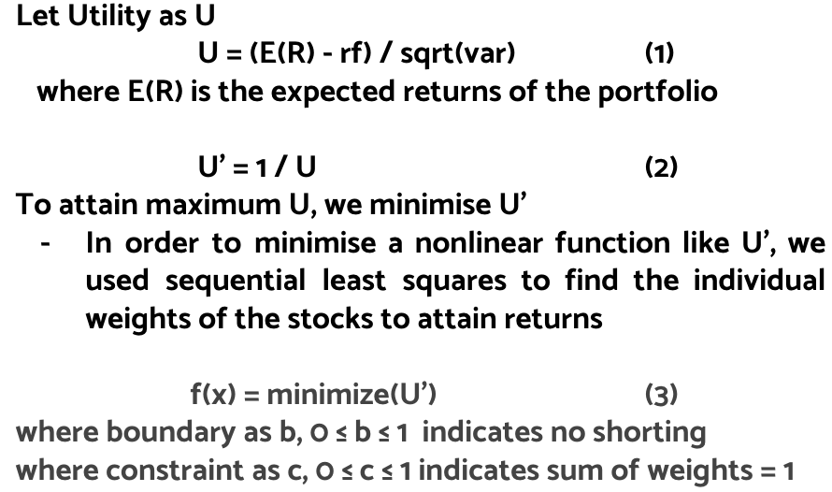
Step 1: Stock Selection
Step 2: Optimising Portfolio
Step 3: Backtest Portfolio
Backtesting with Rolling Validation
Universe of all US Stocks between 2003 and 2018
Choose the top 40% of Gross Margin
Choose the top 40% of BM ratio
Choose the smallest 50% of firms
Choose firms with F-Score ≥ 8
Final Portfolio
Collect actual returns of the optimised portfolio for analysis based on the following year’s stock prices

Slide 27
Results
03

Slide 28
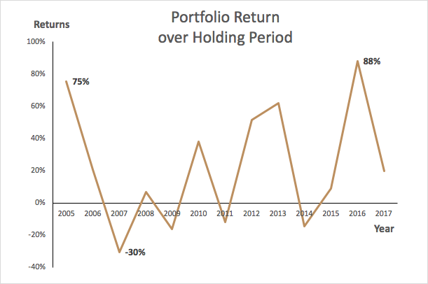
Annual Portfolio Results
Key Takeaways:
Our portfolio has volatile returns
Based on Multiple Signal Selections, such as selecting small cap stocks
Sharpe Ratio | 68.72%
Sortino Ratio | 56.91%
Maximum Drawdown | 66.12%
Maximum Drawdown Duration | 17 Months
Year | ‘05 | ‘06 | ‘07 | ‘08 | ‘09 | ‘10 | ‘11 | ‘12 | ‘13 | ‘14 | ‘15 | ‘16 | ‘17
Ret% | 75.4 | 20.8 | -30.4 | 6.94 | -16.3 | 38.2 | -11.6 | 51.4 | 62.0 | -14.4 | 8.99 | 88.1 | 19.9
Notes:
There may be reasons to explain certain periods of portfolio performance, such as the poor macroeconomic conditions in 2007 to 2009 that resulted in poor or negative growth.

Slide 29
Relative Comparison

Slide 30
BENCHMARKS
1.
S&P 500
2.
Russell 2000
iShares Core S&P Small Cap ETF
3.
All rounded Comparison
Represents approx 75% of the market.
Small-Cap
Small-Cap

Slide 31
RESULTS
 | Sharpe Ratio | Sortino Ratio | Maximum Drawdown | Maximum Drawdown Duration
Our Portfolio | 68.72% | 56.91% | 66.12% | 17 Months
S&P 500 | 52.97% | 238.27% | 52.56% | 16 Months
Russell 2000 | 48.79% | 223.87% | 54.08% | 21 Months
iShares Core S&P Small Cap ETF | 41.09% | 271.97% | 51.97% | 21 Months
Notes:
talk about the metrics we use- sharpe and sortino (alpha per unit of risk)- rfr expected to be 0

Slide 32
COMPARISON WITH S&P500
 | Sharpe Ratio | Sortino Ratio | Maximum Drawdown | Maximum Drawdown Duration
Our Portfolio | 68.72% | 56.91% | 66.12% | 17 Months
S&P 500 | 52.97% | 238.27% | 52.56% | 16 Months
S&P500 Market-Cap Weighted: mostly Large Cap (More Stable)
Larger companies -> Larger cash balances -> Share Repurchase/R&D
Notes:
Large companies tend to have larger cash balances to weather through difficult economic times by buying back shares or investing heavily in R&D that will promote future growth.

Slide 33
COMPARISON WITH SMALL CAP INDICES
 | Sharpe Ratio | Sortino Ratio | Maximum Drawdown | Maximum Drawdown Duration
Our Portfolio | 68.72% | 56.91% | 66.12% | 17 Months
Russell 2000 | 48.79% | 223.87% | 54.08% | 21 Months
iShares Core S&P Small Cap ETF | 41.09% | 271.97% | 51.97% | 21 Months
Key Takeaway:
Size (in terms of Market Cap) might not be large contributing factor in relation to Performance
Notes:
talk about the metrics we use- sharpe and sortino (alpha per unit of risk)- rfr expected to be 0

Slide 34
B. Limitations

Slide 35
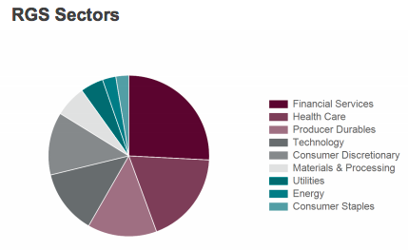
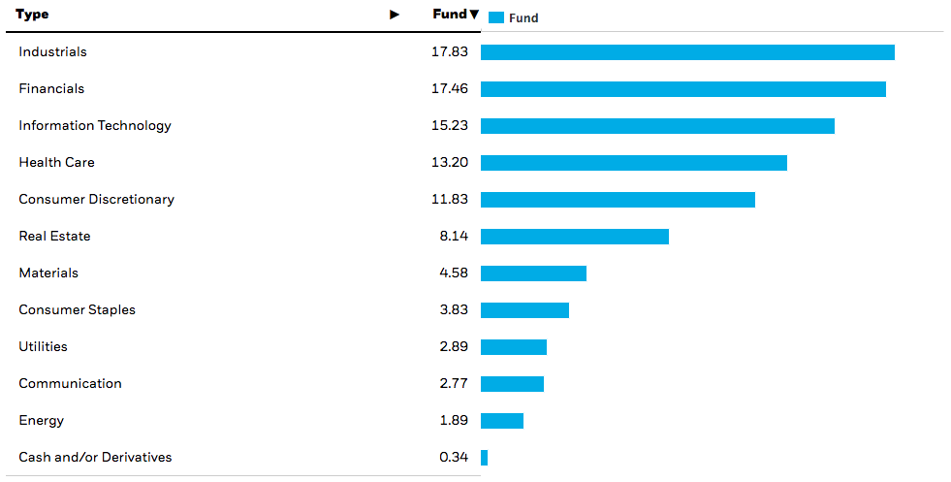
Limitations of our Strategy
Our portfolio is Sharpe-Ratio Optimised, thus it has less emphasis on diversification.
Result: Average annual portfolio size of 20 stocks
In contrast:
Russell 2000 is much more diversified
iShares Core S&P Small Cap ETF is much more diversified and avoids holding illiquid stocks

Slide 36
Recommendations
04

Slide 37
SENTIMENT ANALYSIS

Slide 38

METHODOLOGY
Step 1
Data Collection: Collect financial headline news for a period from 2005-2017
Key Assumption:
All investors are rational.
Step 2
Analyzing Data: Feeding financial news collected into Vader and Textblob to generate sentiment scores
Step 3
Compute average sentiment scores
Step 4
Correlate these scores with annual return to find the coefficient of correlation

Slide 39
Findings
Correlation Coefficients of Variables
 | Returns | Average Score
Returns | 1.00 | -0.3416
Average Score | -0.3416 | 1.00
Key Findings
Exhibits a inverse relationship of -0.3415
Suggests that value stocks will exceed market performance and outperform during bear markets/economic recessions
Corresponds to fundamentals of value investing
Sentiment indicators act as signals for traders holding on to value stocks.
Disaggregated sentiment scores of industry-specific news can help with diversification and portfolio allocation
Overall higher alpha reaped.

Slide 40
CONCLUSION
Our strategy is Sharpe Ratio optimisation and therefore it has outperformed the market in sharpe ratio
With greater diversification and with greater focus on lowering downside risk, we believe that our returns will be improved

Slide 41

THANK YOU

